Slide 1
Sales Insights
File created on: 9/5/2021 5:25:23 PM

Slide 2
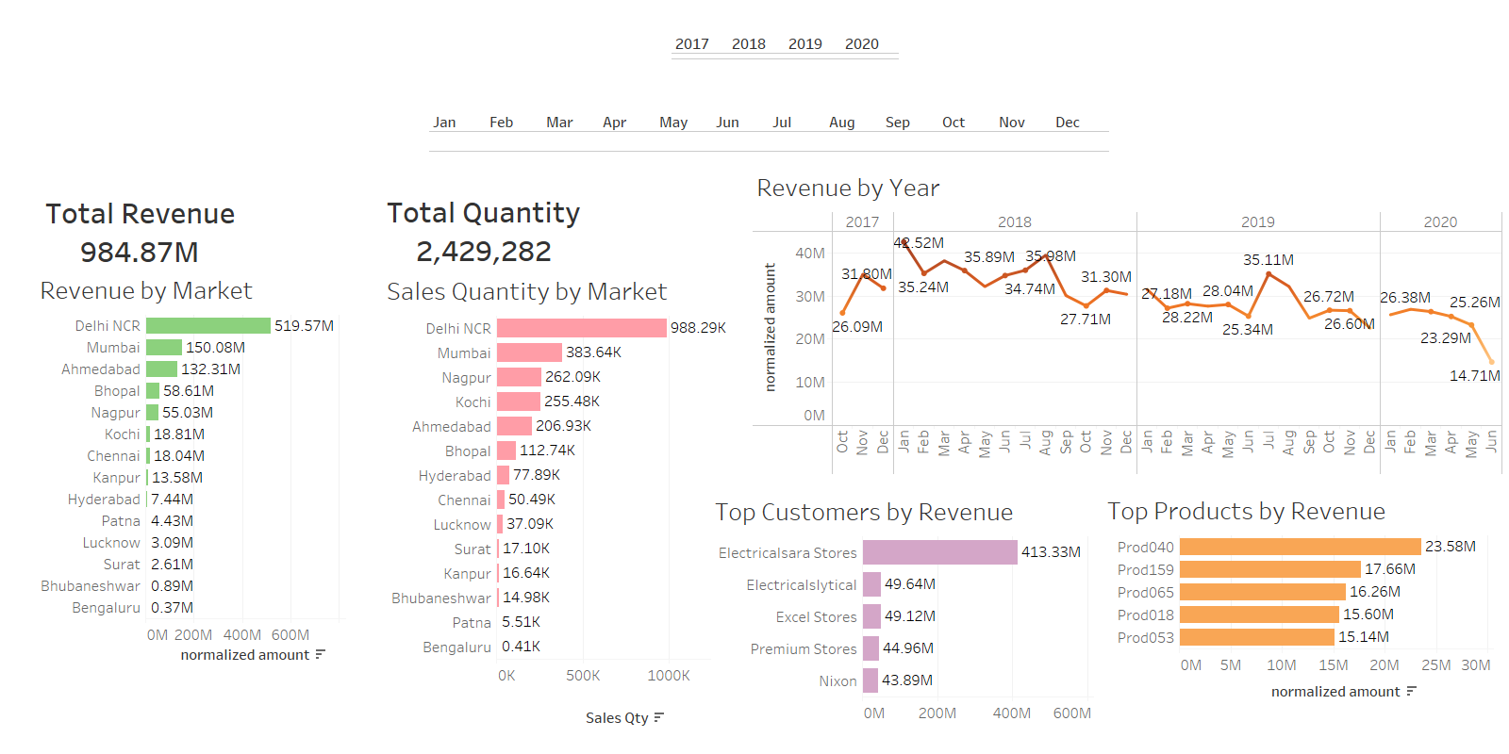
Revenue Analysis

Slide 3
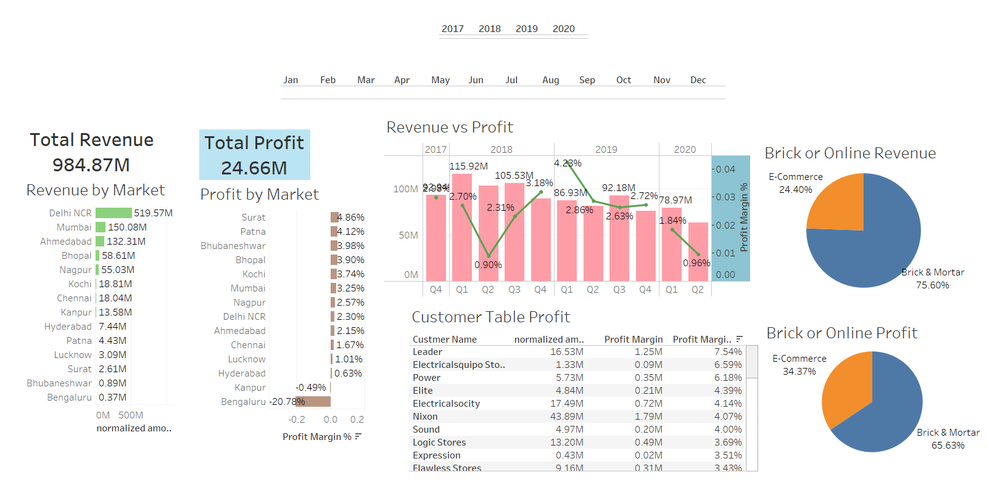
Profit Analysis

